Slide 1

Chapter 11
Experimental Design
and
Analysis of Variance

Slide 2
An Introduction to Experimental Design and Analysis of Variance
Statistical studies can be classified as being either experimental or observational.
In an experimental study, one or more factors are controlled so that data can be obtained about how the factors influence the variables of interest.
In an observational study, no attempt is made to control the factors.
Cause-and-effect relationships are easier to establish in experimental studies than in observational studies.
Analysis of variance (ANOVA) can be used to analyze the data obtained from experimental or observational studies.

Slide 3
An Introduction to Experimental Design and Analysis of Variance
A factor is a variable that the experimenter has selected for investigation.
A treatment is a level of a factor.
Experimental units are the objects of interest in the experiment.
A completely randomized design is an experimental design in which the treatments are randomly assigned to the experimental units.

Slide 4
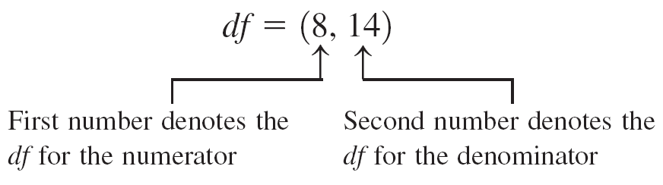
Introduction to F distribution
The F distribution is continuous and skewed to the right.
The F distribution has two numbers of degrees of freedom: df for the numerator and df for the denominator.
The units of an F distribution, denoted F, are nonnegative.

Slide 5
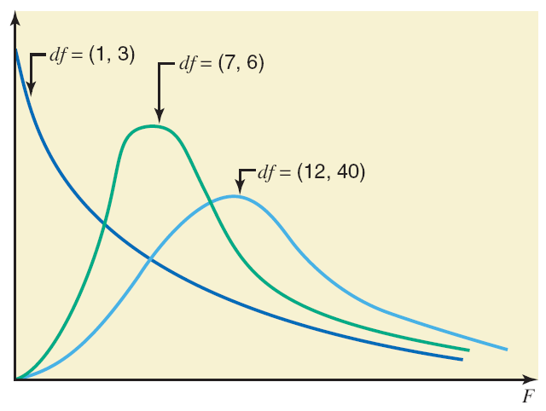
Three F Distribution Curves.

Slide 6
Analysis of Variance: A Conceptual Overview
Analysis of Variance (ANOVA) can be used to test for the equality of three or more population means.
Data obtained from observational or experimental studies can be used for the analysis.
We want to use the sample results to test the following hypotheses:
H₀: μ₁ = μ₂ = μ₃ = . . . = μ_{k}
H_{a}: Not all population means are equal

Slide 7
Analysis of Variance: A Conceptual Overview
If H₀ is rejected, we cannot conclude that all population means are different.
Rejecting H₀ means that at least two population means have different values.

Slide 8
Analysis of Variance: A Conceptual Overview
Assumptions for Analysis of Variance
For each population, the response (dependent) variable is normally distributed.
The variance of the response variable, denoted σ ², is the same for all of the populations.
The observations must be independent.

Slide 9
Analysis of Variance and the Completely Randomized Design
Between-Treatments Estimate of Population Variance
Within-Treatments Estimate of Population Variance
Comparing the Variance Estimates: The F Test
ANOVA Table

Slide 10
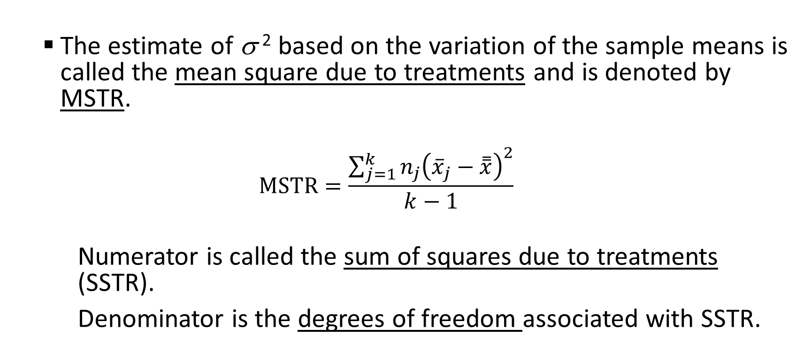
Between-Treatments Estimate of Population Variance σ ²
The estimate of σ ² based on the variation of the sample means is called the mean square due to treatments and is denoted by MSTR.
$$MSTR=\frac{\sum_{j=1}^{k}{n_{j}{\left({\overline{x}}_{j}−\overset{̿}{x}\right)}^{2}}}{k−1}$$
Numerator is called the sum of squares due to treatments (SSTR).
Denominator is the degrees of freedom associated with SSTR.

Slide 11
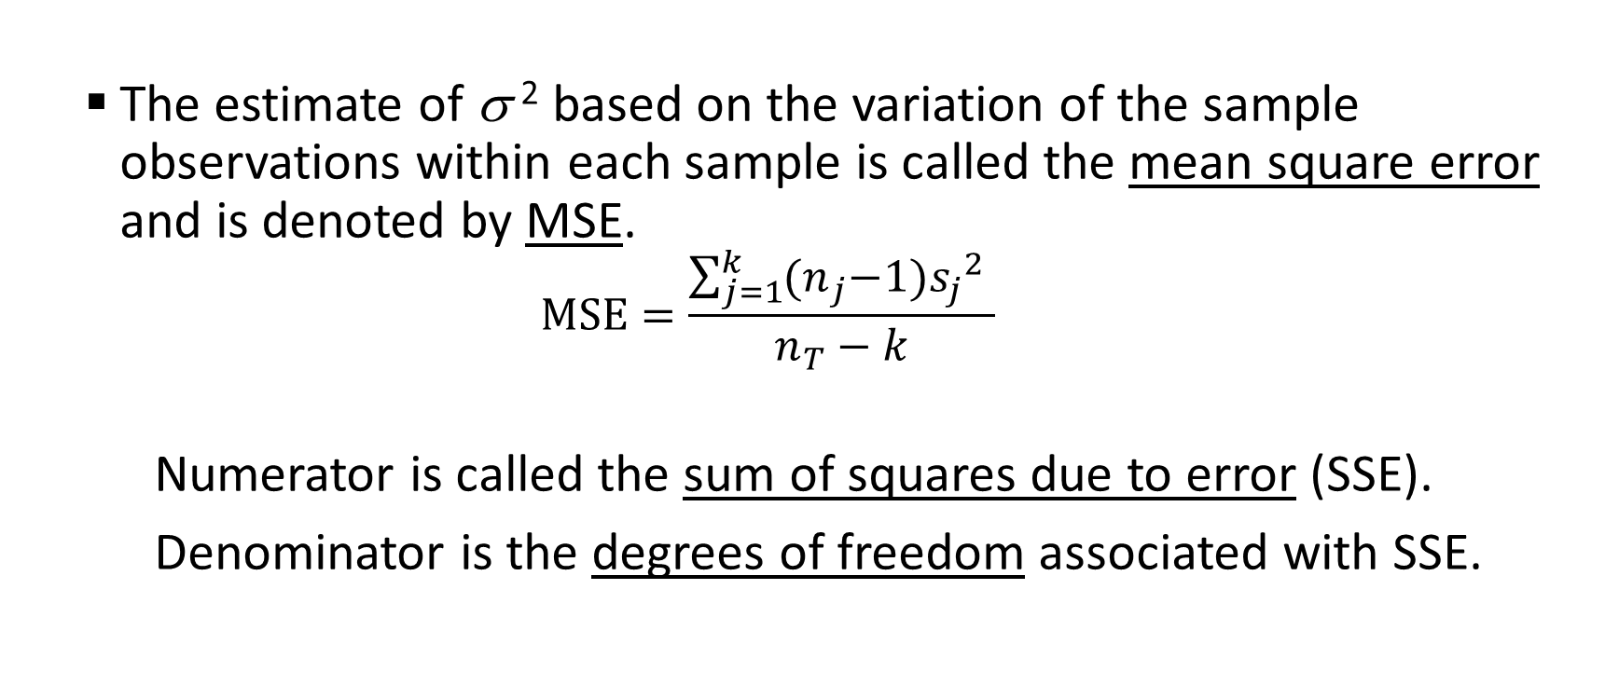
Within-Treatments Estimate of Population Variance σ ²
The estimate of σ ² based on the variation of the sample observations within each sample is called the mean square error and is denoted by MSE.
$$MSE=\frac{\sum_{j=1}^{k}{{(n}_{j}−1){s_{j}}^{2} }}{n_{T}−k}$$
Numerator is called the sum of squares due to error (SSE).
Denominator is the degrees of freedom associated with SSE.

Slide 12
Comparing the Variance Estimates: The F Test
Sampling Distribution of MSTR/MSE
Reject H₀
Do Not Reject H₀
α
MSTR/MSE
F_{α}
Critical Value

Slide 13
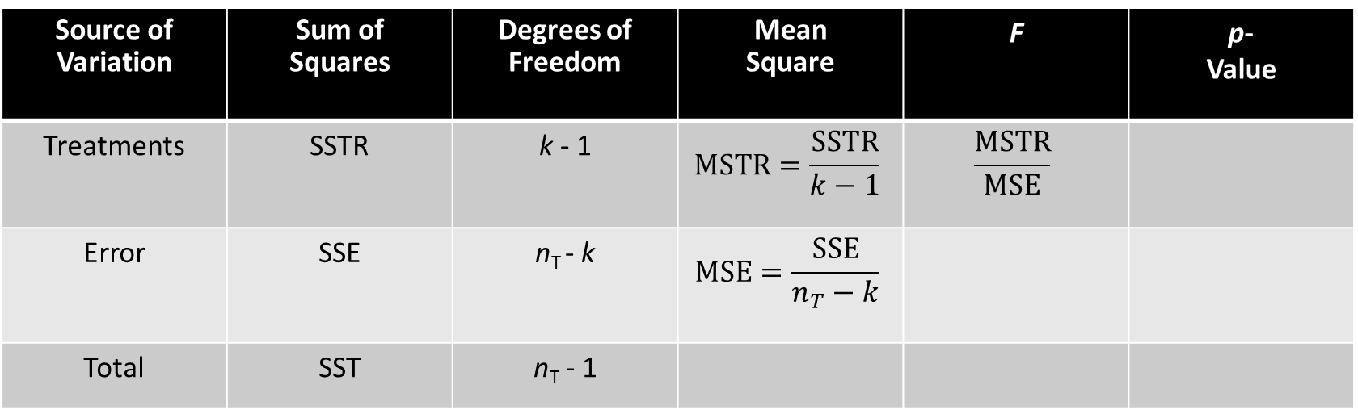
ANOVA Table for a Completely Randomized Design
Source of Variation | Sum of Squares | Degrees of Freedom | Mean Square | F | p- Value
Treatments | SSTR | k - 1 | $$MSTR=\frac{SSTR}{k−1}$$ | $$\frac{MSTR}{MSE}$$
Error | SSE | n_{T} - k | $$MSE=\frac{SSE}{n_{T}−k}$$
Total | SST | n_{T} - 1
SST is partitioned
into SSTR and SSE.
SST’s degrees of freedom (d.f.) are
partitioned into SSTR’s d.f. and SSE’s d.f.

Slide 14
ANOVA Table for a Completely Randomized Design
ANOVA can be viewed as the process of partitioning the total sum of squares and the degrees of freedom into their corresponding sources: treatments and error.
Dividing the sum of squares by the appropriate degrees of freedom provides the variance estimates, the F value and the p-value used to test the hypothesis of equal population means.

Slide 15
Test for the Equality of k Population Means
Hypotheses
H₀: μ₁ = μ₂ = μ₃ = . . . = μ_{k}
H_{a}: Not all population means are equal
Test Statistic
F = MSTR/MSE

Slide 16
Test for the Equality of k Population Means
Rejection Rule
p-value Approach: Reject H₀ if p-value < α
Critical Value Approach: Reject H₀ if F > F_{α}
where the value of F_{α} is based on an F distribution
with k - 1 numerator d.f. and n_{T} - k denominator d.f.

Slide 17
Testing for the Equality of k Population Means: A Completely Randomized Design
Example: Chemitech experiment
Chemitech developed a new filtration system for municipal water supplies. There are different methods that can be used to assemble the system. Chemitech has narrowed down to three methods – A, B and C and wants to determine which assembly method can produce the greatest number of filtration systems per week.

Slide 18
Testing for the Equality of k Population Means: A Completely Randomized Design
Example: Chemitech experiment
For the purpose, it selected 15 workers and then randomly assigned each of the three treatments to 5 of the workers.
Factor – Assembly method
Treatments – A, B and C
Experimental units – Employees
Response units – Number of units produced

Slide 19
Testing for the Equality of k Population Means: A Completely Randomized Design
Observation | A | B | C
1 | 58 | 58 | 48
2 | 64 | 69 | 57
3 | 55 | 71 | 59
4 | 66 | 64 | 47
5 | 67 | 68 | 49
Sample mean | 62 | 66 | 52
Sample variance | 27.5 | 26.5 | 31.0
Sample standard deviation | 5.244 | 5.148 | 5.568

Slide 20
Testing for the Equality of k Population Means: A Completely Randomized Design
Example: Chemitech experiment
Hypotheses
H₀: μ₁ = μ₂ = μ₃
H_{a}: Not all the means are equal
where:
μ₁ = mean number of units produced per week using method A
μ₂ = mean number of units produced per week using method B
μ₃ = mean number of units produced per week using method C

Slide 21
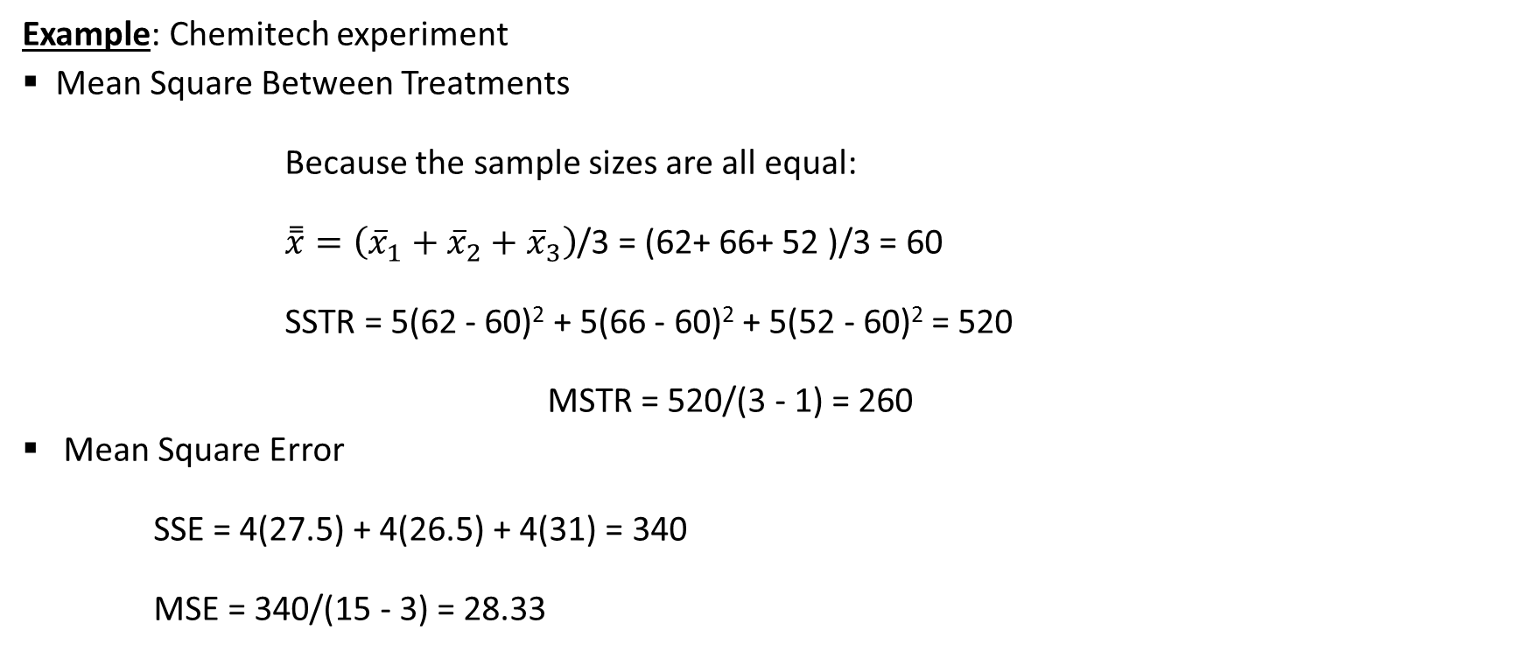
Testing for the Equality of k Population Means: A Completely Randomized Design
Example: Chemitech experiment
Mean Square Between Treatments
Because the sample sizes are all equal:
$\overset{̿}{x}=\left({\overline{x}}_{1}+{\overline{x}}_{2}+{\overline{x}}_{3}\right)$/3 = (62+ 66+ 52 )/3 = 60
SSTR = 5(62 - 60)² + 5(66 - 60)² + 5(52 - 60)² = 520
MSTR = 520/(3 - 1) = 260
Mean Square Error
SSE = 4(27.5) + 4(26.5) + 4(31) = 340
MSE = 340/(15 - 3) = 28.33

Slide 22
Testing for the Equality of k Population Means: A Completely Randomized Design
Example: Chemitech experiment
Rejection Rule
p-Value Approach: Reject H₀ if p-value < .05
Critical Value Approach: Reject H₀ if F > 3.89
where F_{.05} = 3.89 is based on an F distribution with 2 numerator degrees of freedom and 12 denominator degrees of freedom

Slide 23

Testing for the Equality of k Population Means: A Completely Randomized Design
Example: Chemitech experiment
Test Statistic
F = MSTR/MSE = 260/28.33 = 9.18
Conclusion
The p-value is less than .01, where F = 9.18. (Excel provides a p-value of .004.) Therefore, we reject H₀.
There is sufficient evidence to conclude that the means of three populations are not equal.

Slide 24
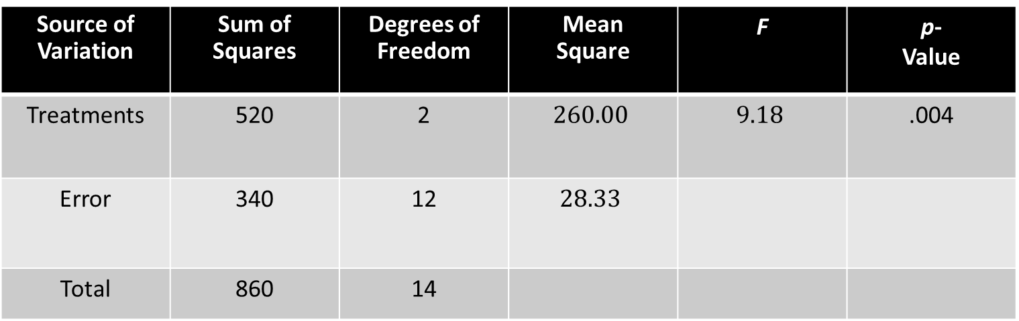
ANOVA Table for a Completely Randomized Design
Example: Chemitech experiment
Source of Variation | Sum of Squares | Degrees of Freedom | Mean Square | F | p- Value
Treatments | 520 | 2 | $$260.00$$ | $$9.18$$ | .004
Error | 340 | 12 | $$28.33$$
Total | 860 | 14

Slide 25
Testing for the Equality of k Population Means: An Observational Study
Example: National Computer Products, Inc. (NCP)
NCP manufactures printers and fax machines at plants located in Atlanta, Dallas and Seattle. To measure how much employees at each plants know about quality management, a random sample of 6 employees was selected from each plant and the employees selected were given quality awareness examination.

Slide 26
Testing for the Equality of k Population Means: An Observational Study
Example: National Computer Products, Inc. (NCP)
Managers want to know if there is significant difference in the mean examination score for the employees at three plants. An F test will be conducted using α = .05.

Slide 27
Testing for the Equality of k Population Means: An Observational Study
Example: National Computer Products, Inc. (NCP)
A simple random sample of 6 employees from each of the three plants was taken and their examination score was tabulated.
Factor – Quality awareness
Treatments – Atlanta, Dallas, Seattle
Experimental units – Employees
Response units – Examination score

Slide 28
Testing for the Equality of k Population Means: An Observational Study
Observation | Atlanta | Dallas | Seattle
1 | 85 | 71 | 59
2 | 75 | 75 | 64
3 | 82 | 73 | 62
4 | 76 | 74 | 69
5 | 71 | 69 | 75
6 | 85 | 82 | 67
Sample mean | 79 | 74 | 66
Sample variance | 34 | 20 | 32
Sample standard deviation | 5.83 | 4.47 | 5.66

Slide 29
Testing for the Equality of k Population Means: An Observational Study
Example: National Computer Products, Inc. (NCP)
p -Value and Critical Value Approaches
Develop the hypotheses.
H₀: μ₁ = μ₂ = μ₃
H_{a}: Not all the means are equal
where: μ ₁ = mean examination score for population 1
μ ₂ = mean examination score for population 2
μ ₃ = mean examination score for population 3

Slide 30
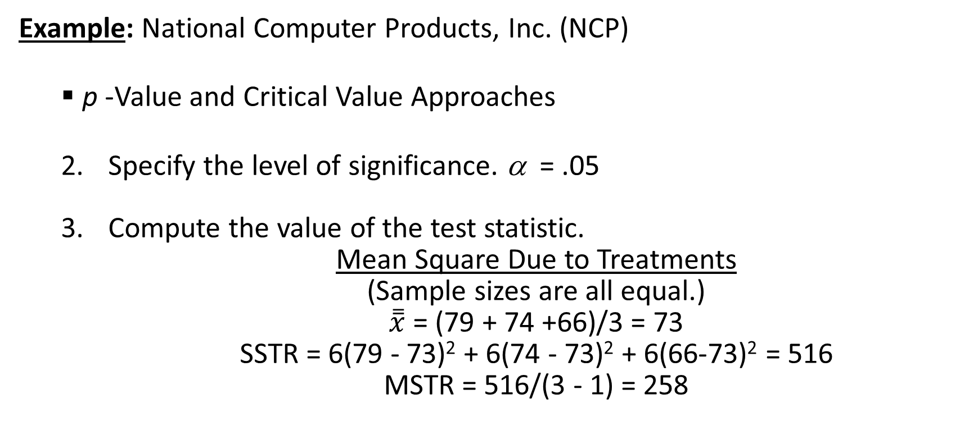
Testing for the Equality of k Population Means: An Observational Study
Example: National Computer Products, Inc. (NCP)
p -Value and Critical Value Approaches
Specify the level of significance. α = .05
Compute the value of the test statistic.
Mean Square Due to Treatments
(Sample sizes are all equal.)
$\overset{̿}{x}$= (79 + 74 +66)/3 = 73
SSTR = 6(79 - 73)² + 6(74 - 73)² + 6(66-73)² = 516
MSTR = 516/(3 - 1) = 258

Slide 31
Testing for the Equality of k Population Means: An Observational Study
Example: National Computer Products, Inc. (NCP)
p -Value and Critical Value Approaches
4. Compute the value of the test statistic.
Mean Square Due to Error
SSE = 5(34.0) + 5(20.0) + 5(32.0) = 430
MSE = 430/(18-3) = 28.667
F = MSTR/MSE = 430/28.667 = 15

Slide 32
Testing for the Equality of k Population Means: An Observational Study
Example: National Computer Products, Inc. (NCP)
Source of Variation | Sum of squares | Degrees of freedom | Mean square | F | p - value
Treatments | 516 | 2 | 258 | 15
Error | 430 | 15 | 28.667
Total | 846 | 17

Slide 33
Testing for the Equality of k Population Means: An Observational Study
Example: National Computer Products, Inc. (NCP)
Rejection Rule
p-Value Approach: Reject H₀ if p-value < .05
Critical Value Approach: Reject H₀ if F > 3.68
where F_{.05} = 3.68 is based on an F distribution with 2 numerator degrees of freedom and 15 denominator degrees of freedom

Slide 34
Testing for the Equality of k Population Means: An Observational Study
Example: National Computer Products, Inc. (NCP)
p –Value Approach
Compute the p –value.
With 2 numerator d.f. and 15 denominator d.f., the p-value is .01 for F = 6.36. Therefore, the p-value is less than .01 for F = 15.
Determine whether to reject H₀.
The p-value < .05, so we reject H₀.

Slide 35
Testing for the Equality of k Population Means: An Observational Study
Example: National Computer Products, Inc. (NCP)
Critical Value Approach
4. Determine the critical value and rejection rule.
Based on an F distribution with 2 numerator d.f. and 15 denominator d.f., F_{.05} = 3.68, Reject H₀ if F > 3.68
Determine whether to reject H₀.
Because F = 15 > 3.68, we reject H₀.
We can conclude that the mean examination scores of employees working at different plants is not the same.

Slide 36
End of Chapter 11

